Slide 1
Workshop materials
Repository: https://github.com/nuitrcs/CoDEx-Github-Gui-Workshop/
Consult request form: bit.ly/rcdsconsult
RCDS listserv signup: https://listserv.it.northwestern.edu/scripts/wa.exe?SUBED1=NUIT-research&A=1

Slide 2


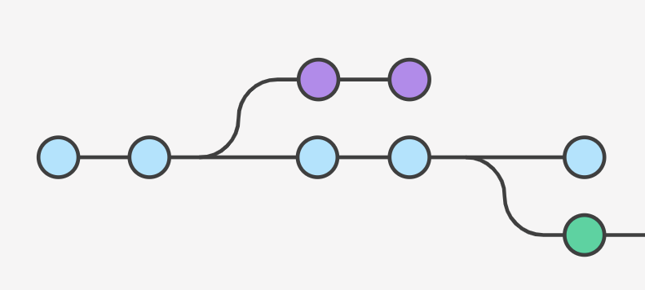

Version Control Using GitHub
Tobin Magle and John Lee
Research Computing and Data Services
April 2nd, 2024

Slide 3


Today we're going to cover:
What is version control?
What is git?
Version control using GitHub
Collaboration in GitHub

Slide 4
How to get help after today's talk
bit.ly/rcdsconsult
We provide free consultations for programming, data science, and data management issues that are related to research

Slide 5
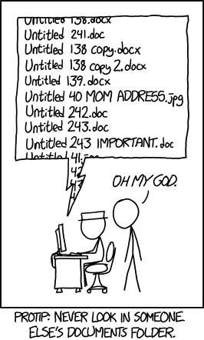
Manual Version Control
“Renaming files”
Creates many files
Relies on your ability to name files consistently
Not designed for collaboration
https://xkcd.com/1459/
Notes:
Version control systems like git, mercurial, and subversion, do so many things
It presents the most recent version of the file and saves a record of the changes that have been made to the file behind the scenes
Saving a record of all changes essentially creates “unlimited redo”
Additionally, they record who made what change and when, which helps with collaboration and accountability
And if collaborators make conflicting changes, git identifies these conflicts and provides a mechanism for resolving them.

Slide 6
Version Control Systems
“Unlimited undo”
One file, many versions
Records who made what change when
Good for collaboration: identifies and helps resolve conflicting changes
Solo
Collaborative
Notes:
Version control systems like git, mercurial, and subversion, do so many things
It presents the most recent version of the file and saves a record of the changes that have been made to the file behind the scenes
Saving a record of all changes essentially creates “unlimited redo”
Additionally, they record who made what change and when, which helps with collaboration and accountability
And if collaborators make conflicting changes, git identifies these conflicts and provides a mechanism for resolving them.

Slide 7

Today we're using git
Built for large software development projects
Can get complicated, but the basics are simple
Free, open source
Many online resources/tutorials
https://xkcd.com/1597/
Notes:
Git specifically is a good option for version control system at the moment because
It’s free and open source
Thus, there are a lot of free resources and tutorials to learn how to use it and to troubleshoot problems.
It’s a distributed version control system which means that it can store copies of the repository on many computers and a central server, making it less likely that you’ll lose all your work due to hardware failure.

Slide 8
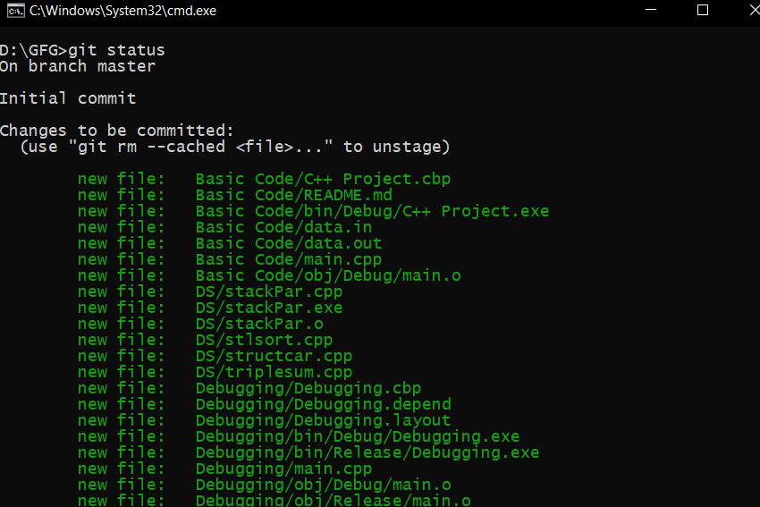
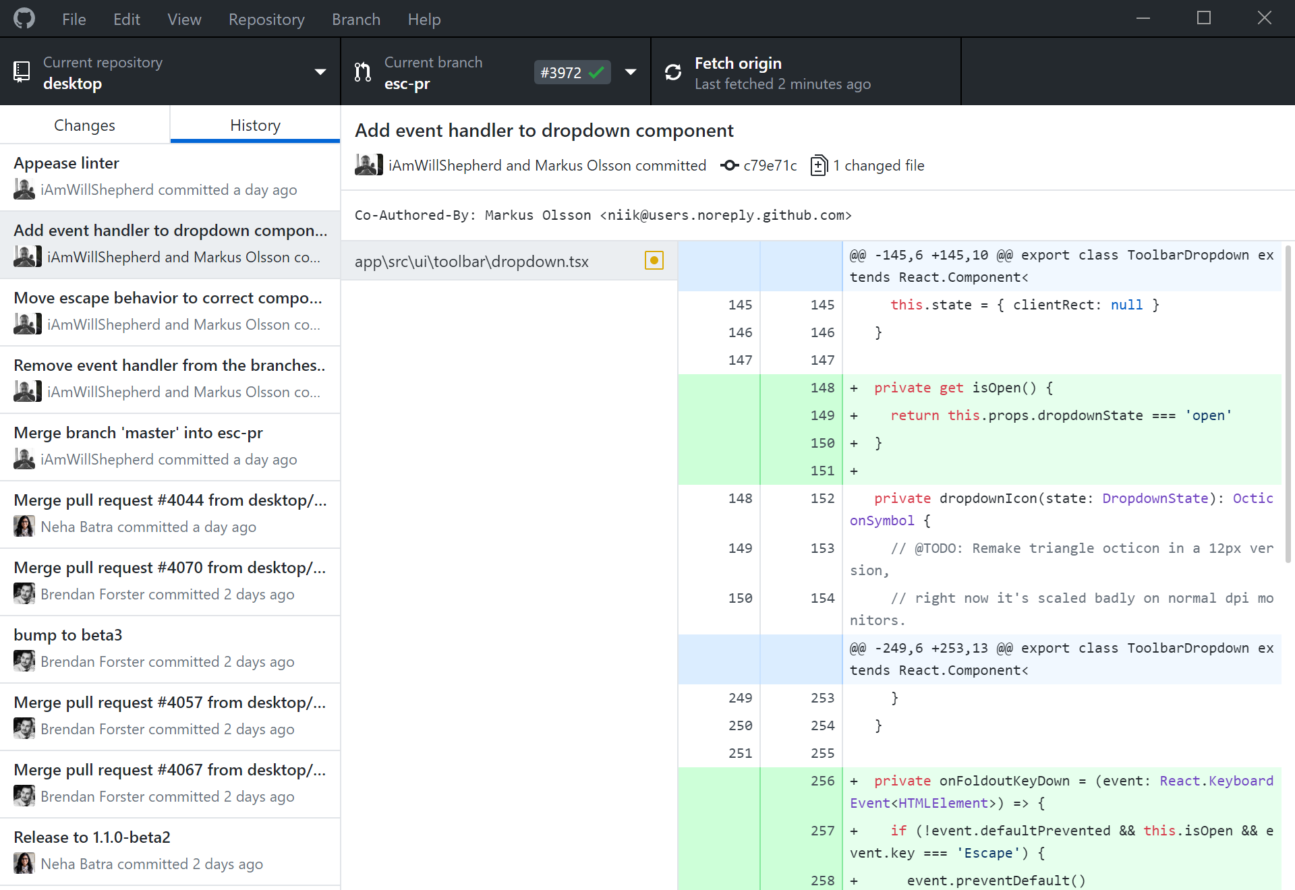
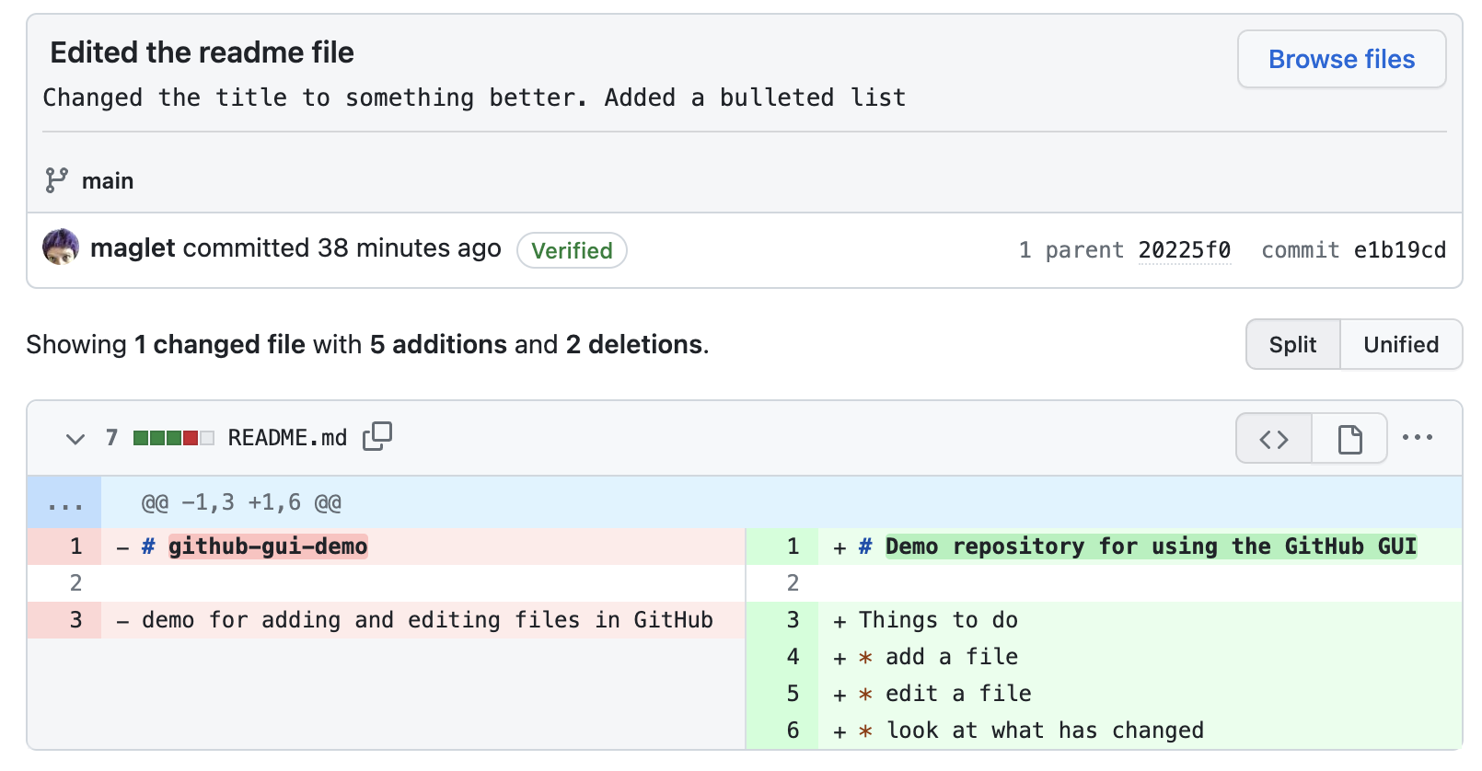
Ways to use Git
Command line
Desktop Clients
GitHub Website

Slide 9
Ways to use Git
Command line
Desktop Clients
GitHub Website

Slide 10

GitHub is a place to
Store your work remotely
Free public repositories
Unlimited private repositories with Northwestern GitHub Org
Edit files in the web browser
Collaborate
https://services.northwestern.edu/TDClient/30/Portal/Requests/ServiceDet?ID=55
Notes:
The most common remote server that people use is Github
Git provides remote storage for your work
It allows storage for public repositories for free to everyone
However, you can get free unlimited private repositories for freeif you associate your account with a Northwestern github organization

Slide 11
GitHub best practices
GitHub is for code and documentation, not data
No protected or personal data on GitHub, even in a private repo
Don't store credentials in your code. Store private keys or tokens a separate file outside of your repository
Add a personal email to your GitHub account, so you can use it when you leave Northwestern
Notes:
The most common remote server that people use is Github
Git provides remote storage for your work
It allows storage for public repositories for free to everyone
However, you can get free unlimited private repositories for freeif you associate your account with a Northwestern github organization

Slide 12

GitHub jargon
Commit - save your changes to the files in the repository – each has a unique id
Repository (“repo”) - a running log of changes that were committed - all you see is the most recent version
History - a list of commits
Diff - compare what has changed between versions line by line
Newest commit
Old commit
Older commit
Oldest commit

Slide 13
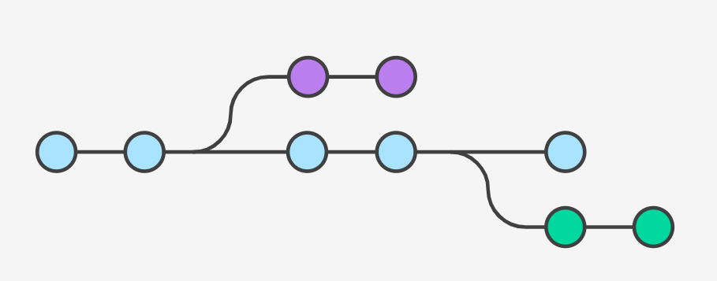
Creating a repository

Slide 14
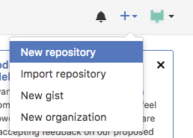
Make an empty GitHub repo
Go to http://github.com
Click the plus sign on the upper right hand side of the screen
Select New repository
Notes:
To make a new github repo:
go to github.com
Click the blue plus sign at the top right and select new repository from the dropdown

Slide 15
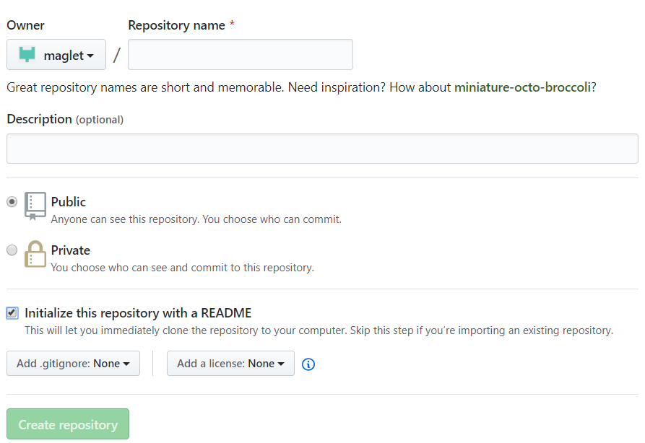
Make an empty repository
Name your repository
Provide a description
Keep it public
Initialize with a README
Create a repo
Notes:
In the new window
give your repository a name - make it specific to you
Provide a description for the project
Keep this repository public for now
And check the box to initialize it with a readme

Slide 16
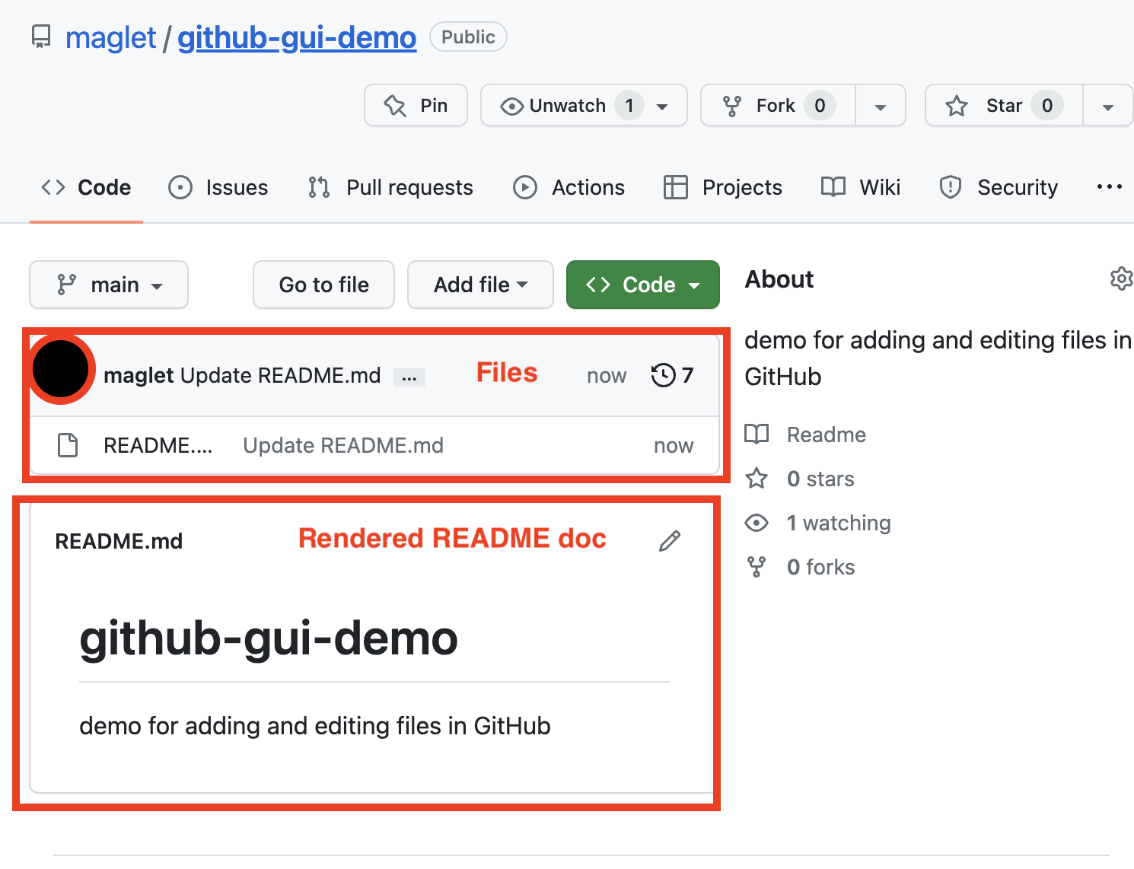
What you should see

Slide 17
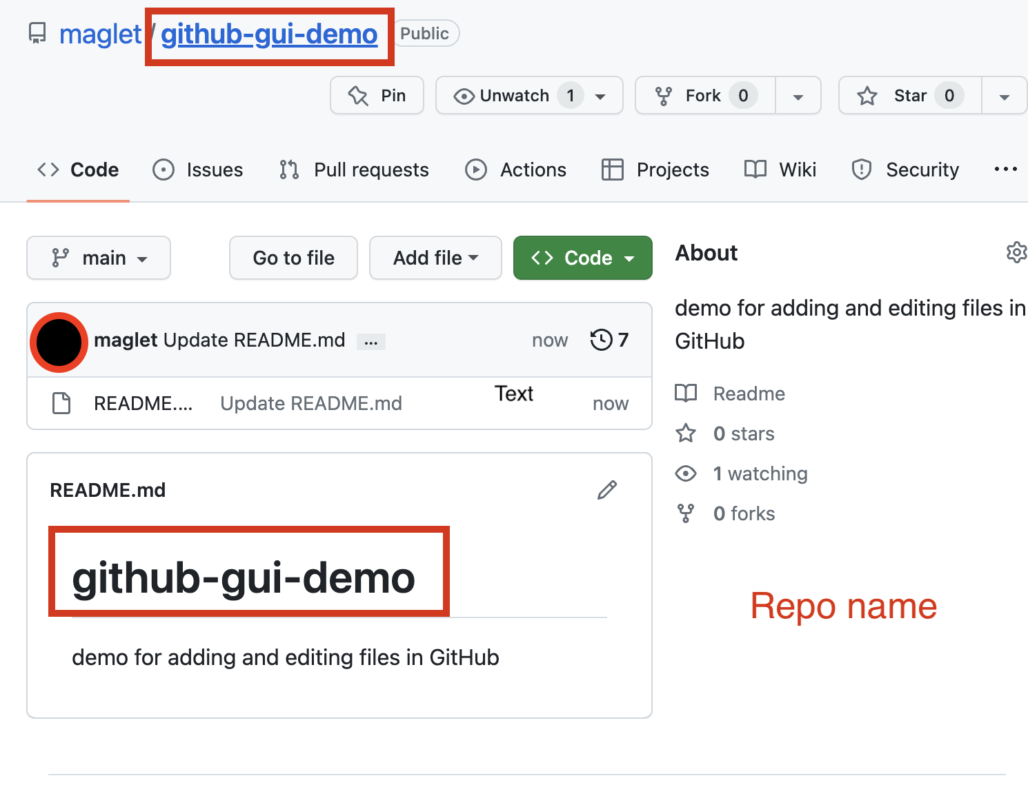
What you should see

Slide 18
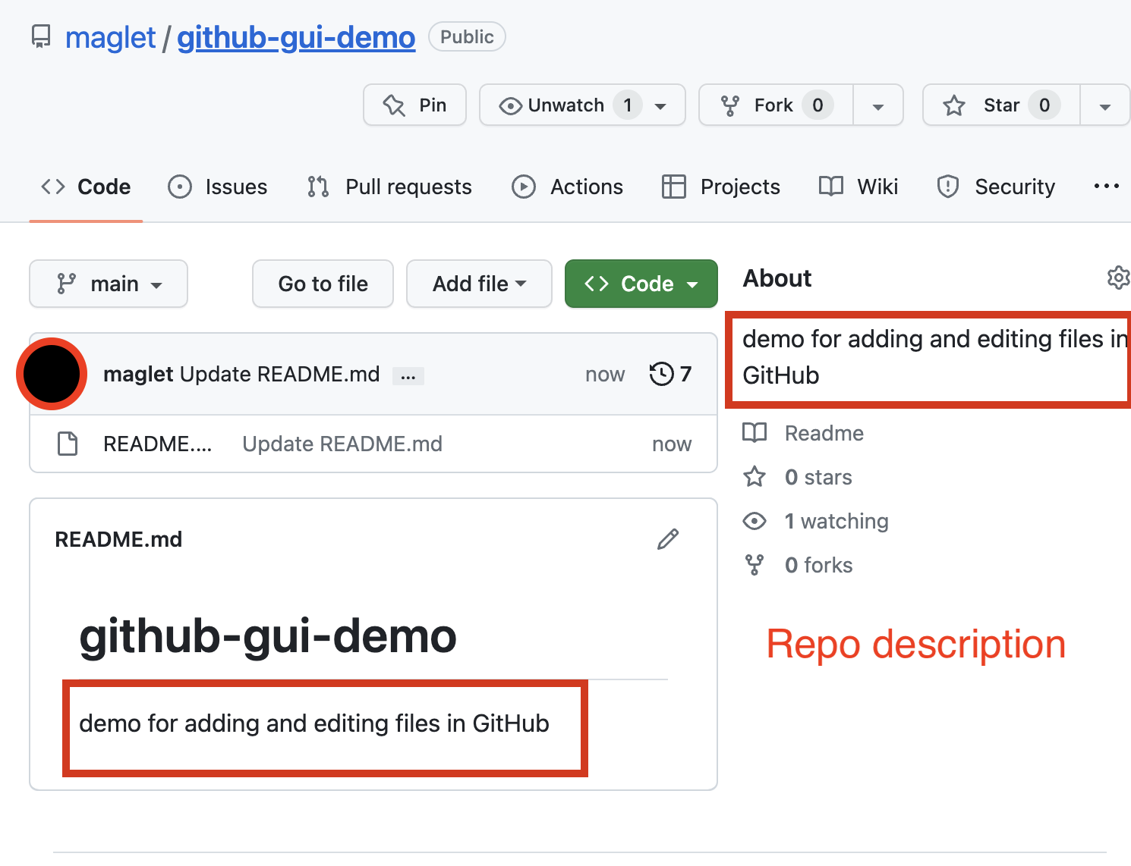
What you should see

Slide 19
Editing files file types, edit, commit

Slide 20
Types of files git works best with
“Good” formats (text based)
“Bad” formats (binary files)
Documents (.txt, .tex, .rtf, .md)
Tabular Data (.csv)
Source code (.R, .py, .c, .sh)
Documents (.docx, .pdf, .ppt)
Excel spreadsheets (.xlsx)
Media (.jpg, .mp3, .mp4)
Databases (.mdb, .sqlite)
https://www.nayuki.io/page/what-are-binary-and-text-files
Notes:
Also as a note, because git relies heavily on text based formats to tell you what has changed in a particular version, it works better with text formats like source code, text files and CSV. You can use it with binary files like the ones on the right, but since git can’t read those files and calculate the changes, it will store a copy of the file every time you commit, making a massive repository and preventing you from seeing the exact changes between files.

Slide 21
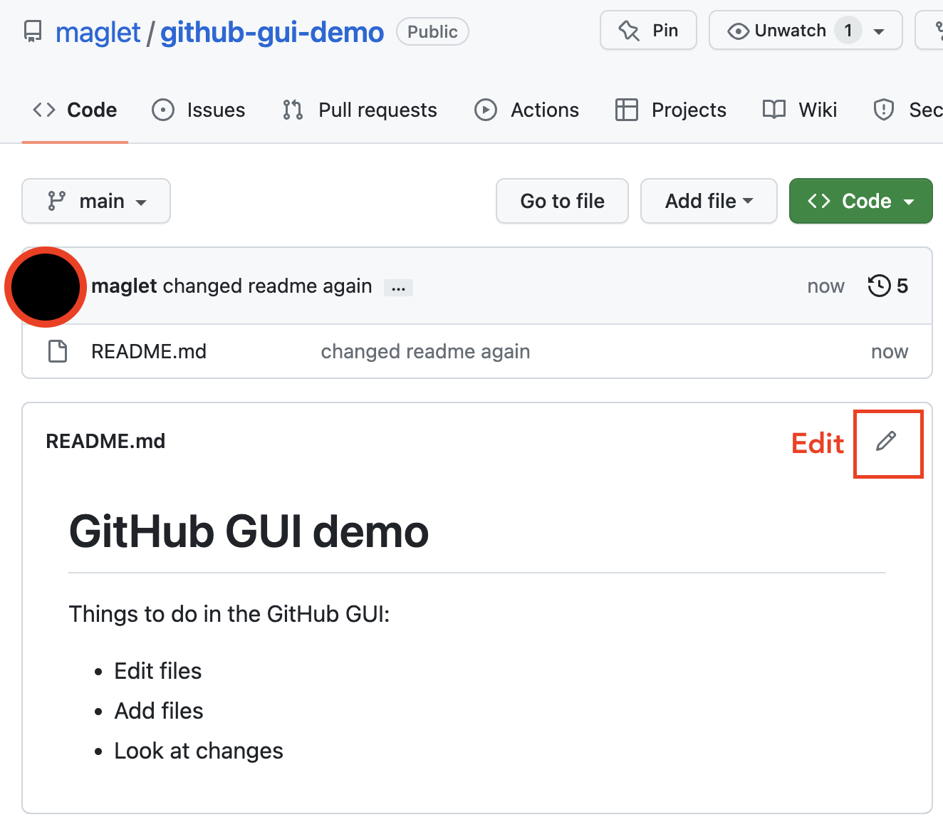
Edit the README file

Slide 22
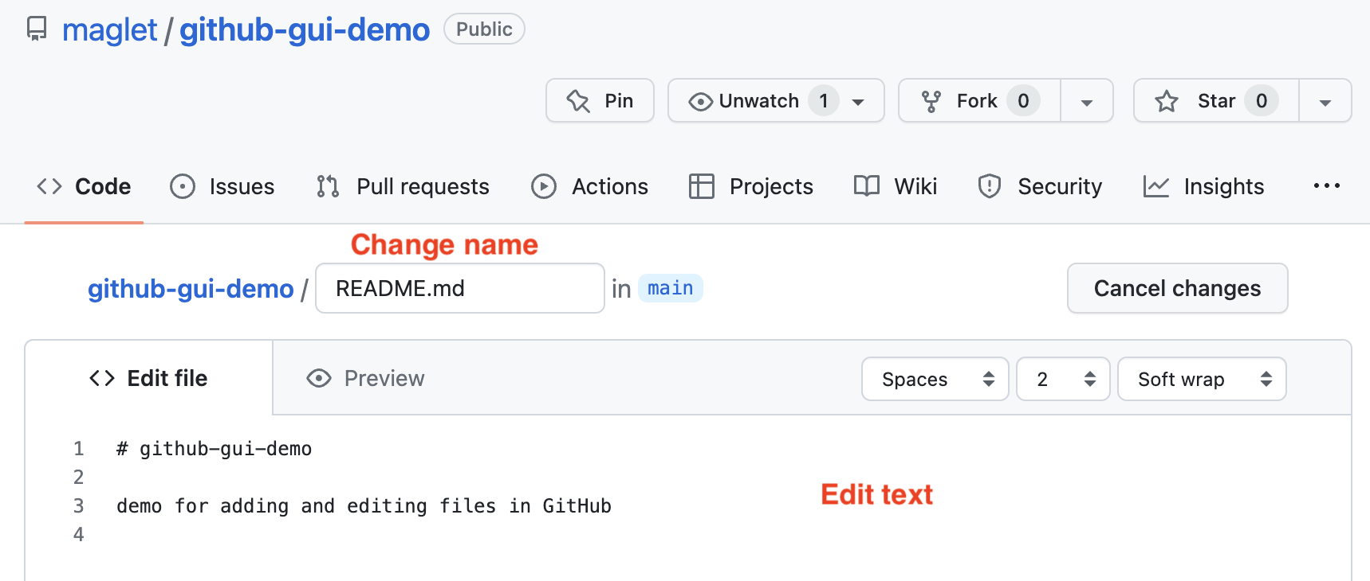
File editor

Slide 23
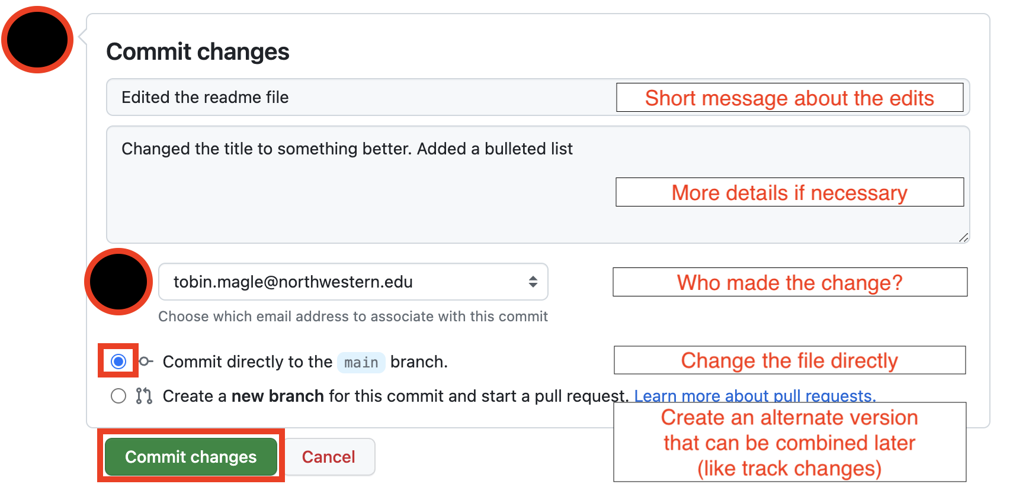
Commit Changes

Slide 24
Examining changes Blame, history, diff

Slide 25
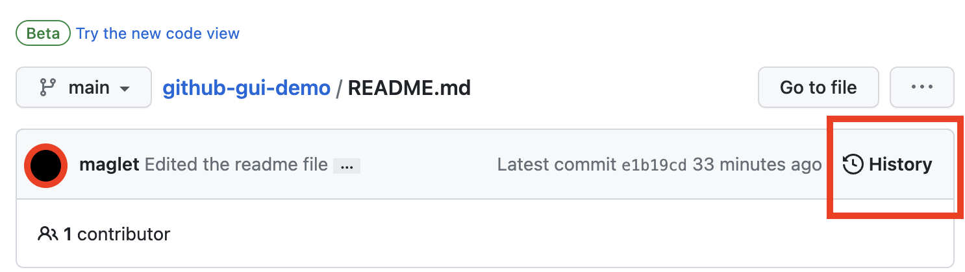
View File History
See all commits that have been made

Slide 26
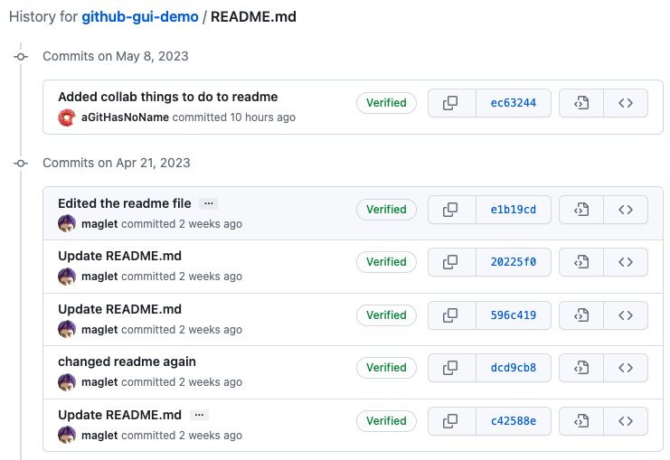
View File History

Slide 27
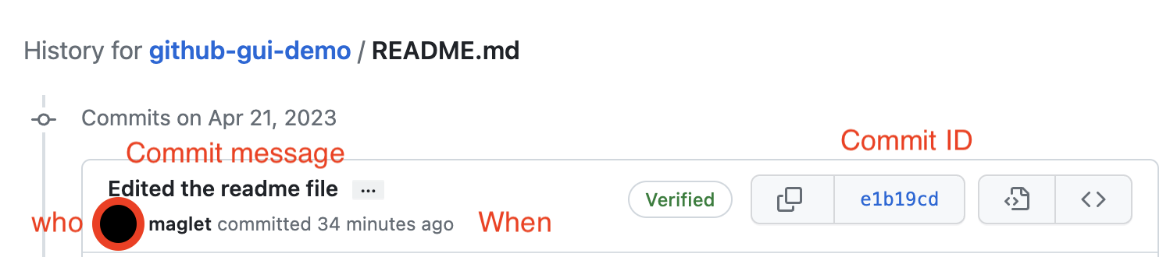
View File History
See who made the commit, when, and the commit message

Slide 28
diff
See what changed in the file line by line
Red = deleted
Green = added

Slide 29
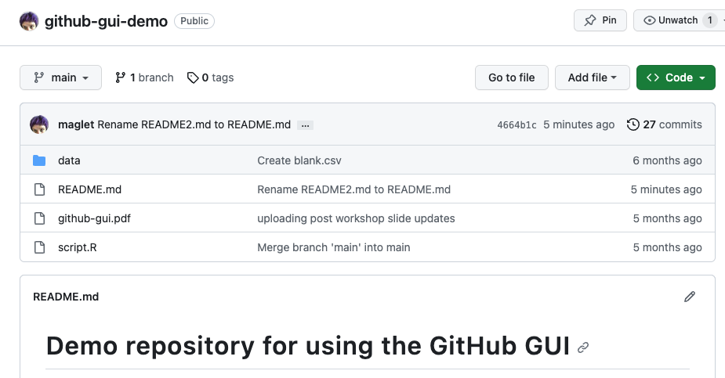
View Repo History
From the main page

Slide 30
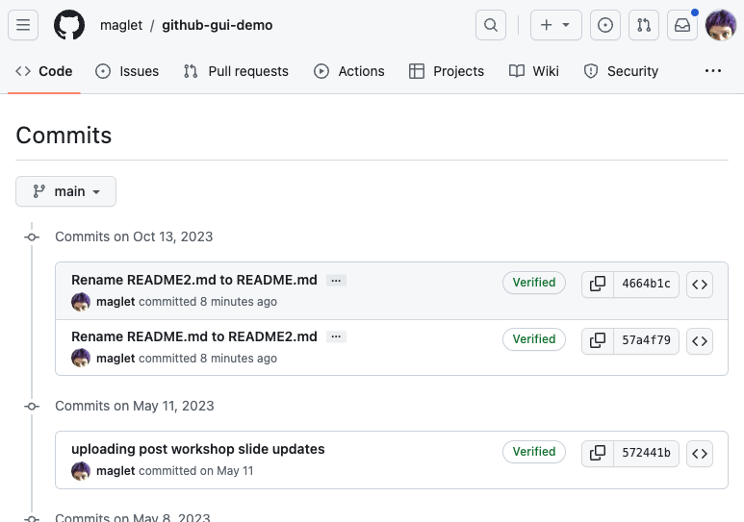
View Repo History

Slide 31
Uploading files

Slide 32
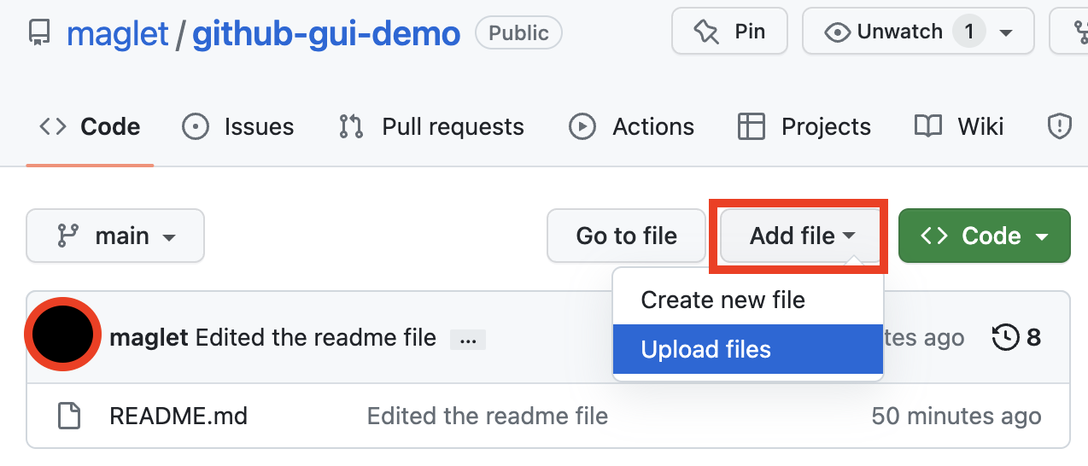
Add a file from your computer

Slide 33
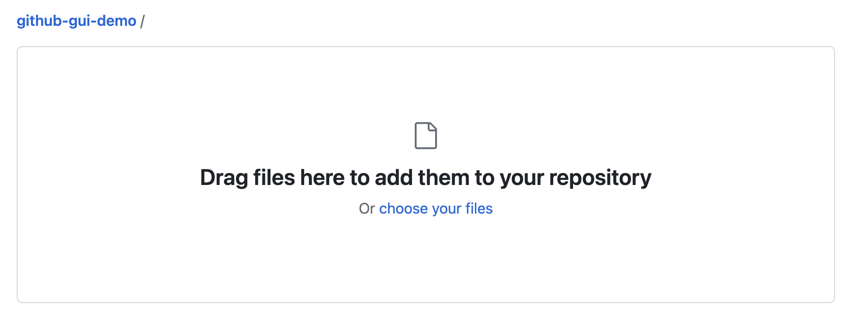
Choose files

Slide 34
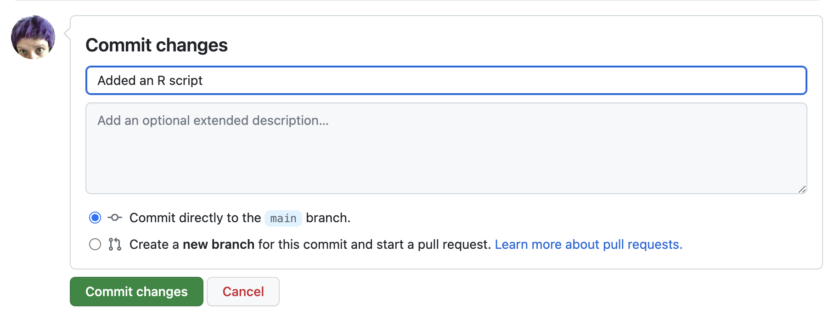
Commit

Slide 35
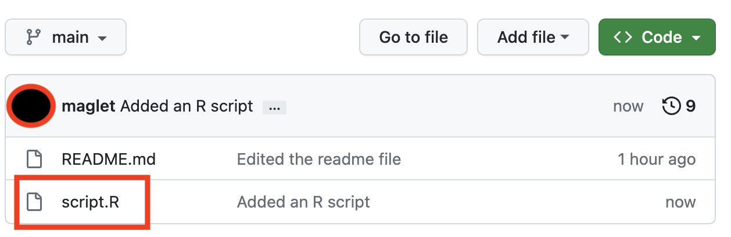
File was added

Slide 36

Running code
Copy and paste - take the lines of code you need to run locally
Download - download most recent version of files
Clone - downloads the whole repository to do version control on your computer
your computer
repo

Slide 37
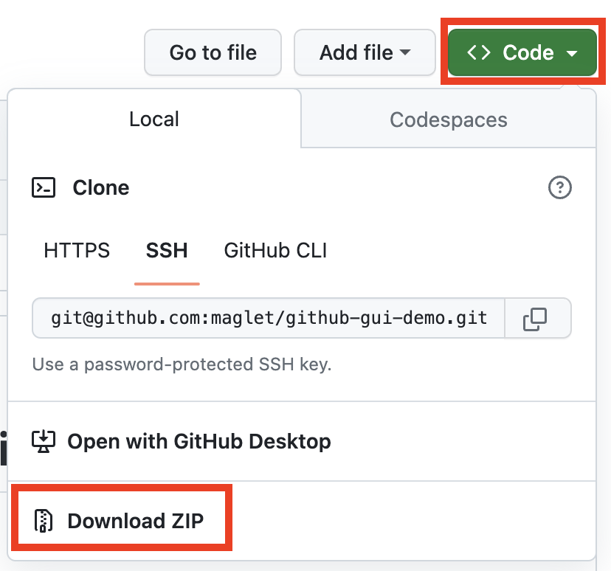
Download
Click the green code button
Click download ZIP
Extract files using a program on your computer
Open your files

Slide 38
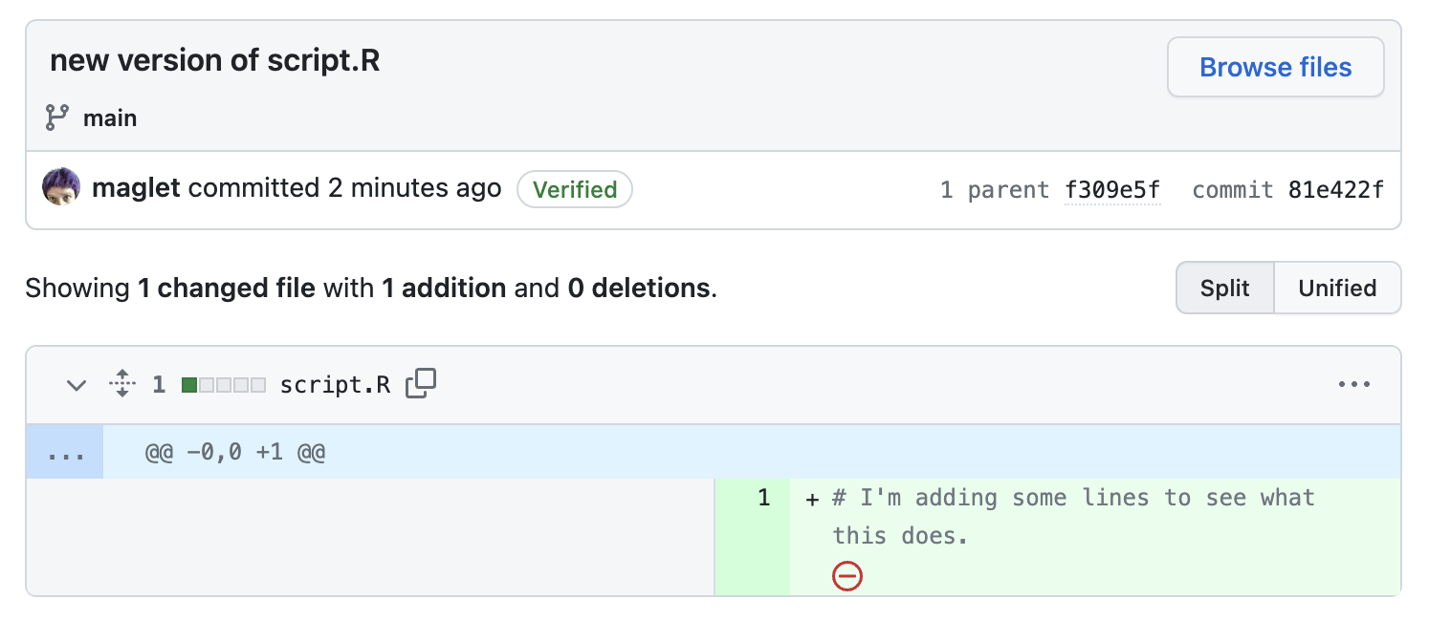
Save changes
Add file > upload file
Select the file you changed
Commit with a message
File is updated

Slide 39

Collaboration through Fork and Pull Request

Slide 40
SO MUCH JARGON with Git

Slide 41
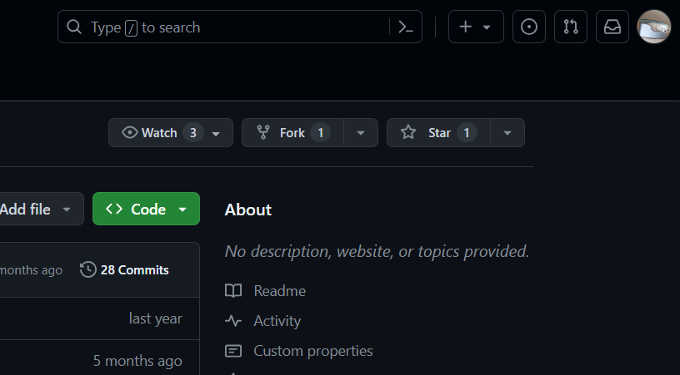
STEP ONE: CREATE A FORK
Link : https://github.com/nuitrcs/CoDEx-Github-Gui-Workshop
Create a Fork from this workshop's repo
this creates a copy of the repo under your own github account (that's all a fork is)
You can now play around the repository as if it was yours without having to worry about affecting the original code.

Slide 42
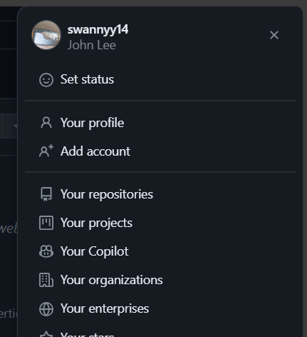
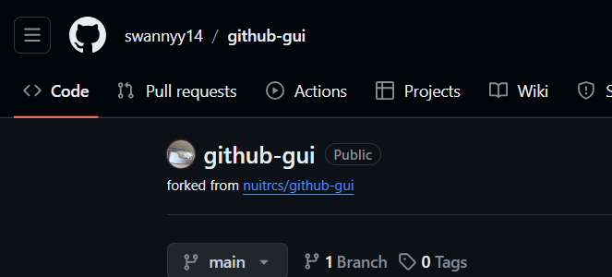
STEP TWO: OPEN your version of the repo
You can see it’s your version of the repo in the top left of your screen.
Click on your account in the top right corner of your screen. Then click on Your repositories. Choose the forked repo.

Slide 43
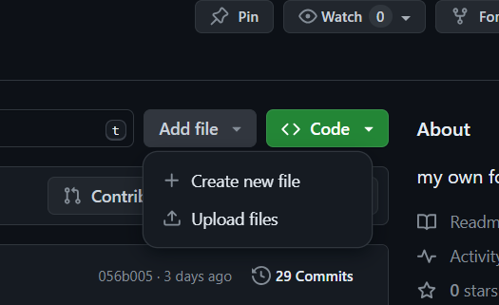
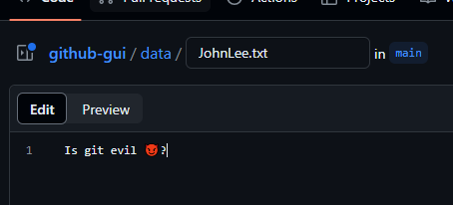
STEP THREE: Create a file in data/ folder
Navigate to the data/ folder in the repository, and create a new file named <your-name.txt>.
Inside the file, write a question you have about Git or Github.

Slide 44
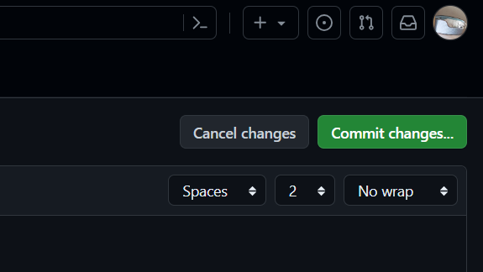
STEP FOUR (a): COMMIT your changes
The "Commit changes" button will light up once you’ve made a change to the file.

Slide 45
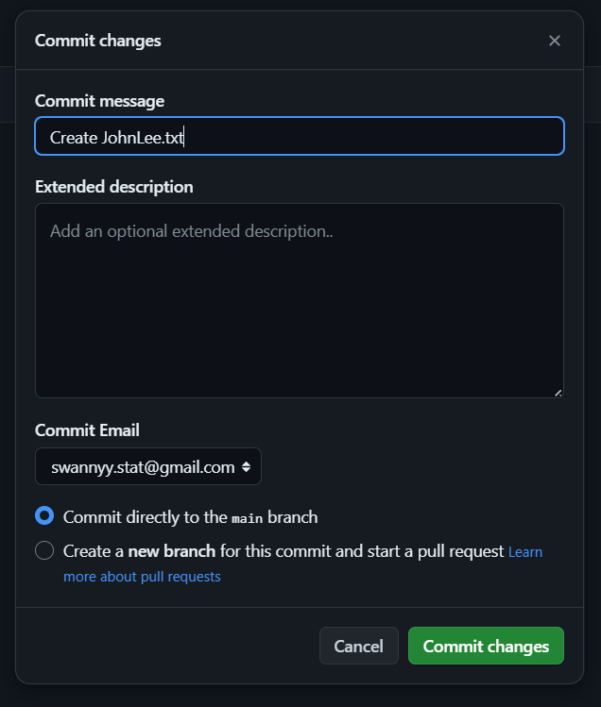
STEP FOUR (b): COMMIT your changes
Name your commit.
You can commit directly to the main branch (that’s the main branch in YOUR version of the repo). This lets you keep working on this file or on other files too before sending all your changes to your friend.

Slide 46
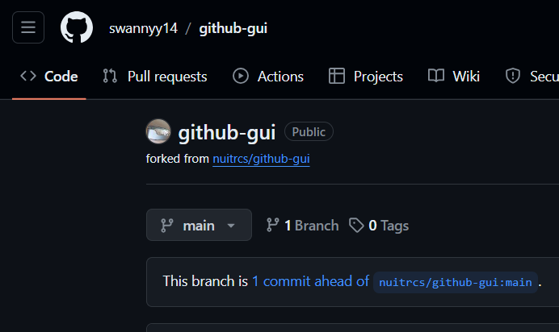
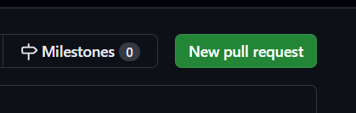
STEP FIVE (a): Create a PULL request
1
2

Slide 47
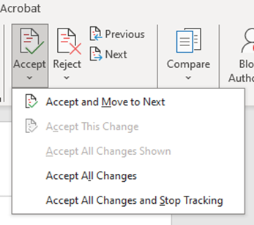
PUSH
PULL
AKA "Create a pull request" when working with someone else’s repo
Make changes (AKA commits) to your version of the repo and ask them to accept those changes into their version of the repo
Remember, your friend won’t lose their previous version if they accept your changes – all versions are saved!
Like "Accept all changes" in Microsoft Word when you let someone else review and make suggestions to your doc

Slide 48
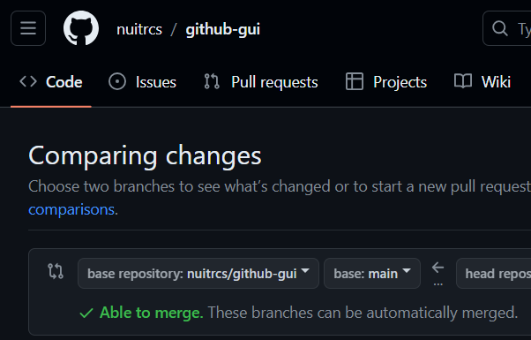
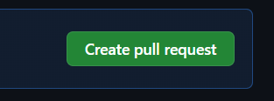
STEP FIVE (b): Create a PULL request
It will now list original version of the repo.
If it says “Able to merge”, click the green "Create pull request" button.
⚠️Oftentimes when you are working on some file that's also being worked on in the original repo, it might say "Can't automatically merge". This is a result of what is called merge conflict, which we might go over if we have time.

Slide 49
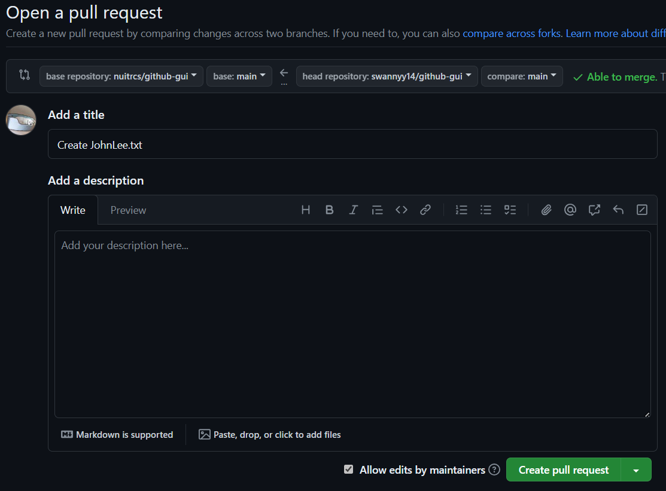
STEP FIVE (c): Create a PULL request
Give the pull request a name. You can also write a comment to your friend.
Click the green button.

Slide 50
STEP FIVE (d): WAIT
Wait for your friend to accept your pull request.
NOTE: "Close a pull request" means CANCEL the pull request.

Slide 51
Accepting a Pull Request

Slide 52
Since only the owner and collaborator of the repository can accept pull requests, you can sit back and watch us accept a pull request.

Slide 53
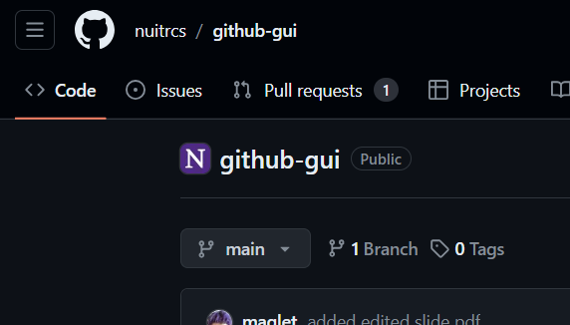
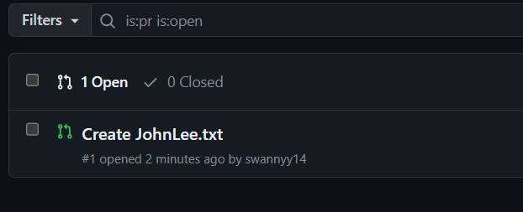
STEP ONE: Open the pull request
Click on "Pull requests" in your repo.
Choose the appropriate pull request from the menu.

Slide 54
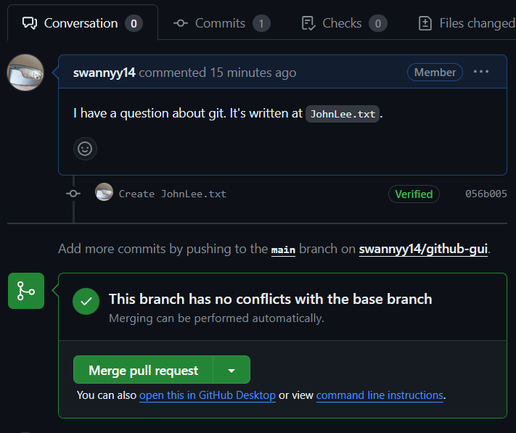
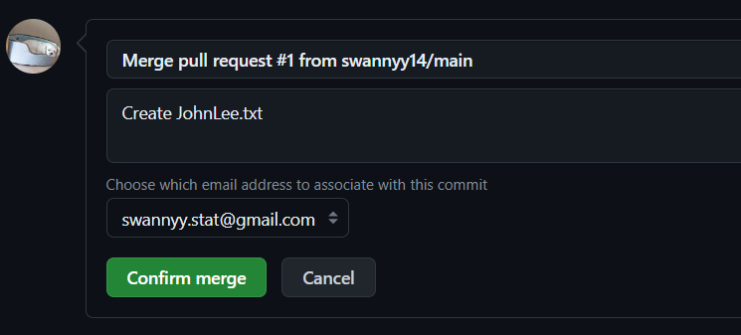
STEP TWO: MERGE your friend’s changes into your repo
You can check what changes have been committed in the "Commits" tab.
Click on “Merge pull request”, then “Confirm merge”
NOTE: You can reject a pull request by "Closing" it.

Slide 55
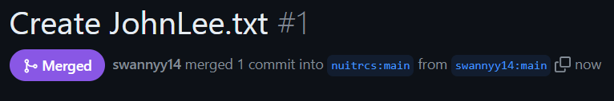
STEP TWO: MERGE your friend’s changes into your repo
It worked!

Slide 56
Other Ways to Collaborate: Create an Issue

Slide 57
OPEN AN ISSUE
Issues are a great way to
track what still needs to be done on a project
report bugs that need to get fixed
have discussions about the what, why, how, and who of your code and documentation

Slide 58
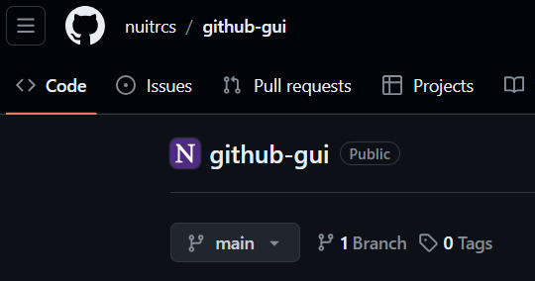
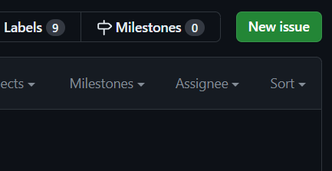
OPEN AN ISSUE
On your friend’s repo, click Issues.
Then click New issue.

Slide 59
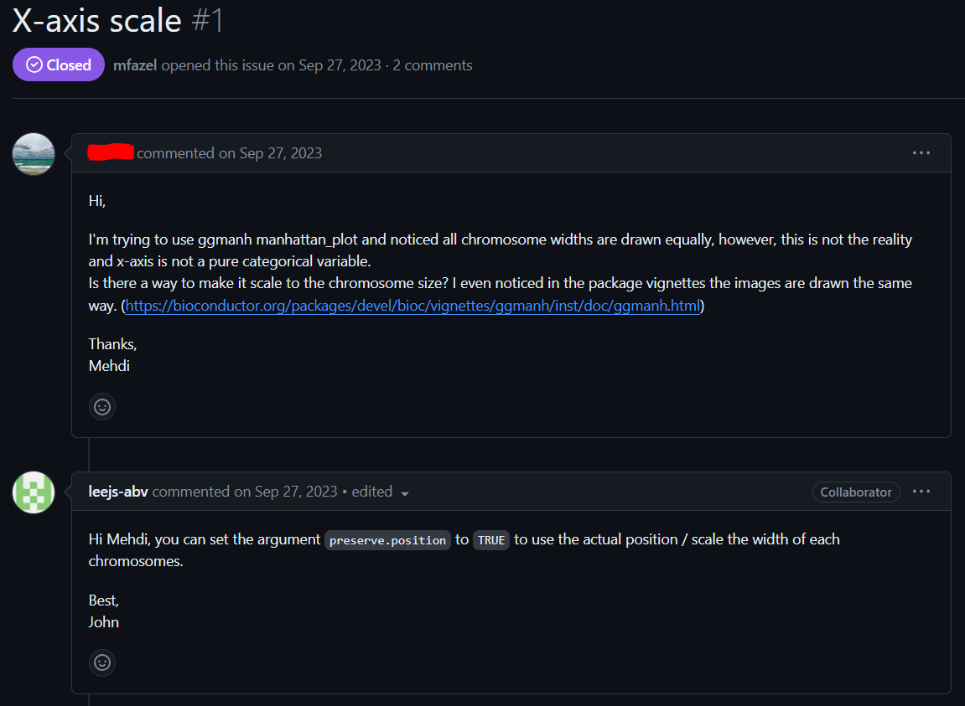
OPEN AN ISSUE
Submitting an issue will start a discussion thread.

Slide 60
Interested in learning more?

Slide 61
Resources
This repository provides additional examples of why you should Git in your scientific workflow
https://github.com/mikecroucher/Git_Academic_Benefits
Git is also very powerful when using it from a command line. To learn how to use Git from the command line, take a look at a tutorial from Software Carpentry
https://swcarpentry.github.io/git-novice/
If you would like to use Git from your local computer without having to worry about using command line, here are some additional options
GitHub Desktop: https://desktop.github.com/
You can also perform many Git operations in R Studio: https://happygitwithr.com/rstudio-git-github.html
Using Git from VS Code: https://code.visualstudio.com/docs/sourcecontrol/github

Slide 62
Questions?

